Slide 1
Operations Management
William J. Stevenson
8th edition

Slide 2
Product and Service Design
Major factors in design strategy
  Cost
  Quality
  Time-to-market
  Customer satisfaction
  Competitive advantage
  https://www.youtube.com/watch?v=ZqeA_psKn2E
Product and service design – or redesign – should be
closely tied to an organization’s strategy

Slide 3
Product or Service Design Activities
Translate customer wants and needs into product and service requirements
Refine existing products and services
Develop new products and services
Formulate quality goals
Formulate cost targets
Construct and test prototypes
Document specifications
https://www.youtube.com/watch?v=K3oOmQmS7aY

Slide 4
Reasons for Product or Service Design
Economic(low demand/excessive warranty claims/need to reduce cost)
Social and demographic(baby boomers, population shift)
Political, liability, or legal( govt change/ safety issue, new regulations)
Competitive(new or changed product, new advt/ promotion)
Cost or availability(raw material, energy,labor, water)
Technological( in product components, processes)

Slide 5
Objectives of Product and Service Design
Main focus
  Customer satisfaction
Secondary focus
  Function of product/service
  Cost/profit
  Quality
  Appearance
  Ease of production/assembly
  Ease of maintenance/service

Slide 6
Legal, Ethical, and Environmental Issues
Legal
  FDA
  Product liability
  Uniform commercial code
  Lead based fuel banned / chemicals/dyes/ maida based products
Ethical
  Releasing products with defects- example Volkswagon
Environmental
  EPA

Slide 7
Regulations & Legal Considerations
Product Liability - A manufacturer is liable for any injuries or damages caused by a faulty product.
Uniform Commercial Code - Products carry an implication of merchantability and fitness.

Slide 8
Designers Adhere to Guidelines
Produce designs that are consistant with the goals of the company
Give customers the value they expect
Make health and safety a primary concern
Consider potential harm to the environment

Slide 9
Other Issues in Product and Service Design
Product/service life cycles
How much standardization
Product/service reliability
Range of operating conditions

Slide 10
Life Cycles of Products or Services
Figure 4.1
Saturation
Maturity
Decline
Demand
Growth
Introduction
Time

Slide 11
Standardization
Standardization
  Extent to which there is an absence of variety in a product, service or process
Standardized products are immediately available to customers

Slide 12
Advantages of Standardization
Fewer parts to deal with in inventory & manufacturing
Design costs are generally lower
Reduced training costs and time
More routine purchasing, handling, and inspection procedures

Slide 13
Advantages of Standardization (Cont’d)
Orders fillable from inventory
Opportunities for long production runs and automation
Need for fewer parts justifies increased expenditures on perfecting designs and improving quality control procedures.

Slide 14
Disadvantages of Standardization
Designs may be frozen with too many imperfections remaining.
High cost of design changes increases resistance to improvements.
Decreased variety results in less consumer appeal.

Slide 15
Mass Customization
Mass customization:
  A strategy of producing standardized goods or services, but incorporating some degree of customization.

Slide 16
Delayed Differentiation
Delayed differentiation is a postponement tactic
  Producing but not quite completing a product or service until customer preferences or specifications are known

Slide 17
Modular Design
Modular design is a form of standardization in which component parts are subdivided into modules that are easily replaced or interchanged. It allows:
  easier diagnosis and remedy of failures
  easier repair and replacement
  simplification of manufacturing and assembly

Slide 18
Reliability
Reliability: The ability of a product, part, or system to perform its intended function under a prescribed set of conditions
Failure: Situation in which a product, part, or system does not perform as intended
Normal operating conditions: The set of conditions under which an item’s reliability is specified

Slide 19
Improving Reliability
Component design
Production/assembly techniques
Testing
Preventive maintenance procedures
User education
System design

Slide 20
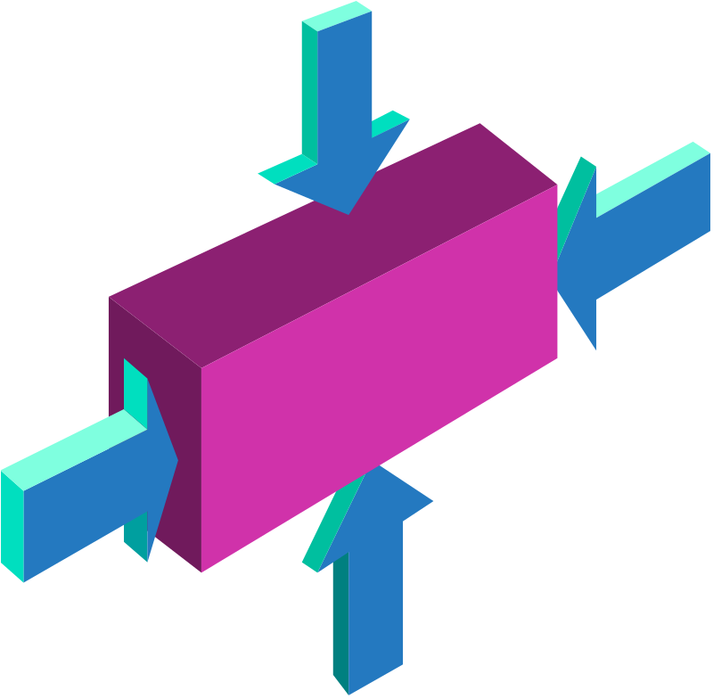
Product Design
Product Life Cycles
Robust Design
Concurrent Engineering
Computer-Aided Design
Modular Design

Slide 21
Robust Design
Robust Design: Design that results in products or services that can function over a broad range of conditions

Slide 22
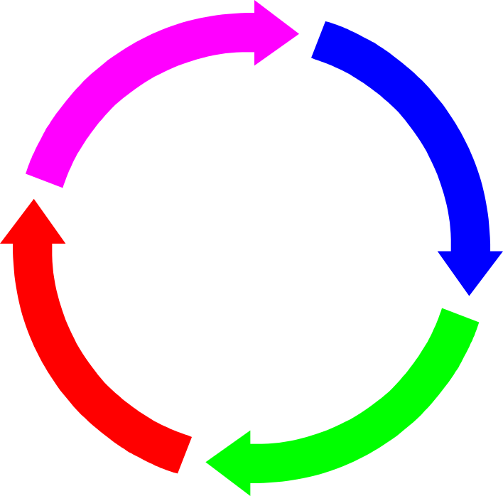
Phases in Product Development Process
Idea generation
Feasibility analysis
Product specifications
Process specifications
Prototype development
Design review
Market test
Product introduction
Follow-up evaluation

Slide 23

Idea Generation
Supply chain based
Ideas
Competitor based
Research based

Slide 24
Reverse Engineering
Reverse engineering is the
dismantling and inspecting
of a competitor’s product to discover product improvements.

Slide 25
Research & Development (R&D)
Organized efforts to increase scientific knowledge or product innovation & may involve:
  Basic Research advances knowledge about a subject without near-term expectations of commercial applications.
  Applied Research achieves commercial applications.
  Development converts results of applied research into commercial applications.

Slide 26
Manufacturability
Manufacturability is the ease of fabrication and/or assembly which is important for:
  Cost
  Productivity
  Quality

Slide 27
Designing for Manufacturing
Beyond the overall objective to achieve customer satisfaction while making a reasonable profit is:
Design for Manufacturing(DFM)
The designers’ consideration of the organization’s manufacturing capabilities when designing a product.
The more general term design for operations encompasses services as well as manufacturing

Slide 28
Concurrent Engineering
Concurrent engineering
is the bringing together
of engineering design and manufacturing personnel
early in the design phase.

Slide 29
Computer-Aided Design
Computer-Aided Design (CAD) is product design using computer graphics.
  increases productivity of designers, 3 to 10 times
  creates a database for manufacturing information on product specifications
  provides possibility of engineering and cost analysis on proposed designs

Slide 30
Product design
Design for manufacturing (DFM)
Design for assembly (DFA)
Design for recycling (DFR)
Remanufacturing
Design for disassembly (DFD)
Robust design

Slide 31
Recycling
Recycling: recovering materials for future use
Recycling reasons
  Cost savings
  Environment concerns
  Environment regulations

Slide 32
Service Design
Service is an act
Service delivery system
  Facilities
  Processes
  Skills
Many services are bundled with products

Slide 33
Service Design
Service design involves
  The physical resources needed
  The goods that are purchased or consumed by the customer
  Explicit services
  Implicit services

Slide 34
Service Design
Service
  Something that is done to or for a customer
Service delivery system
  The facilities, processes, and skills needed to provide a service
Product bundle
  The combination of goods and services provided to a customer
Service package
  The physical resources needed to perform the service

Slide 35
Differences Between Product
and Service Design
Tangible – intangible
Services created and delivered at the same time
Services cannot be inventoried
Services highly visible to customers
Services have low barrier to entry
Location important to service

Slide 36
Phases in Service Design
Conceptualize
Identify service package components
Determine performance specifications
Translate performance specifications into design specifications
Translate design specifications into delivery specifications

Slide 37
Service Blueprinting
Service blueprinting
  A method used in service design to describe and analyze a proposed service
A useful tool for conceptualizing a service delivery system

Slide 38
Major Steps in Service Blueprinting
Establish boundaries
Identify steps involved
Prepare a flowchart
Identify potential failure points
Establish a time frame
Analyze profitability
Example of service provided in courier service centre/ hotel stay/restraunt providing food /hospital – detail of injections medicines given etc.

Slide 39
Characteristics of Well Designed
Service Systems
Consistent with the organization mission
User friendly
Robust
Easy to sustain
Cost effective
Value to customers
Effective linkages between back operations
Single unifying theme
Ensure reliability and high quality

Slide 40
Challenges of Service Design
Variable requirements
Difficult to describe
High customer contact
Service – customer encounter

Slide 41
Quality Function Deployment
Quality Function Deployment
  Voice of the customer
  House of quality
QFD: An approach that integrates the “voice of the customer” into the product and service development process.

Slide 42
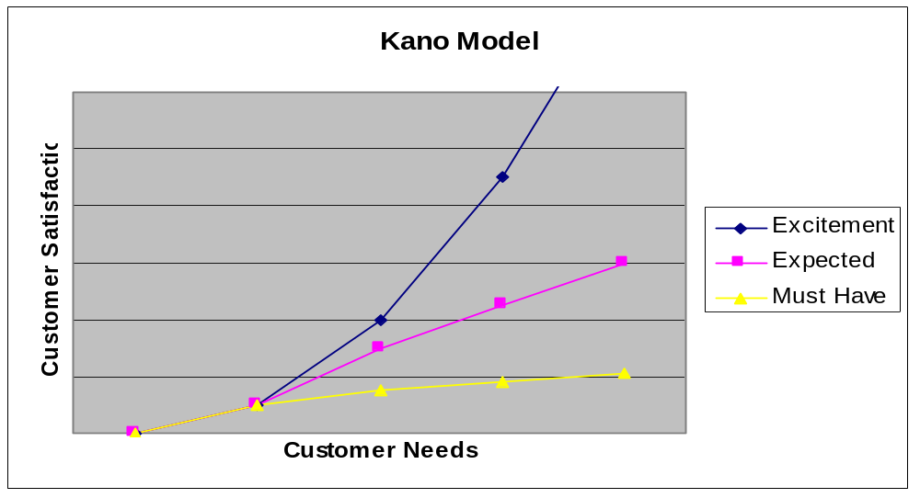
The Kano Model
Figure 4.6

Slide 43
Operations Strategy
Increase emphasis on component commonality
Package products and services
Use multiple-use platforms
Consider tactics for mass customization
Look for continual improvement
Shorten time to market

